Slide 1

Southeast Louisiana
2026 Camp Masters
Welcome to Camp Masters
2026 Selling Program
“Camp Masters is Committed to helping councils maximize participation, increase profitability, and provide an easier fundraising experience for every scout and family”

Slide 2
2026 Southeast Louisisana Product Mix
Customized Products
Code Product
DD Caramel 9 oz $15.00
V Purple Popping Jar $12.00
ZD White Cheddar $20.00
KT Cinnamon 12 oz $20.00
DC Cacao SS Sunflower Seed $20.00
YY Kettle 12 pk $20.00
MM Movie Butter 18 pk $30.00
JK Chicago Style Snack Attack Tin $40.00
ZZ/WW Military Donation $30/$50

Slide 3
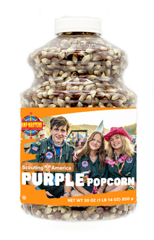
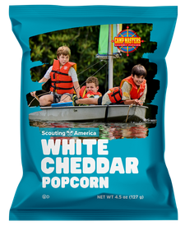
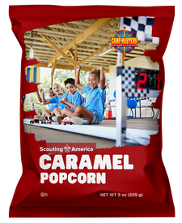
White Cheddar and Purple Popping Jar
$15
$15
$20
$15
PURPLE KERNELS
Mauve gourmet popping corn, ready to pop and sprinkle with your favorite flavorings! Packed in a resealable Jar
WHITE CHEDDAR
Cheesy goodness of white cheddar cheese on light, crunchy, crispy popcorn
CARAMEL
Mouth-watering taste of delicate and crispy Gourmet Caramel Corn.

Slide 4
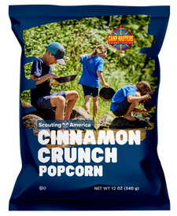

Cinnamon Crunch and Sunflower Seed
$20
$20
Dark Cocoa Sea Salt Sunflower Seed
Crunchy Roasted Sunflower Seed with rich dark cocoa and sea salt for the balance of sweet and salty
CINNAMON CRUNCH
Lightly sweet popcorn with warm, savory cinnamon.

Slide 5


Movie Theater Extra Butter and Kettle Corn
$20
$30
KETTLE CORN
Sweet and Salty old fashioned Kettle Corn that tastes like the popcorn at old time county fairs!
12 Pack
MOVIE THEATER Extra Butter Popcorn
perfectly seasoned with EXTRA Buttery flavor just like the Movie Theaters. America’s #1 selling flavor!
18 Pack

Slide 6
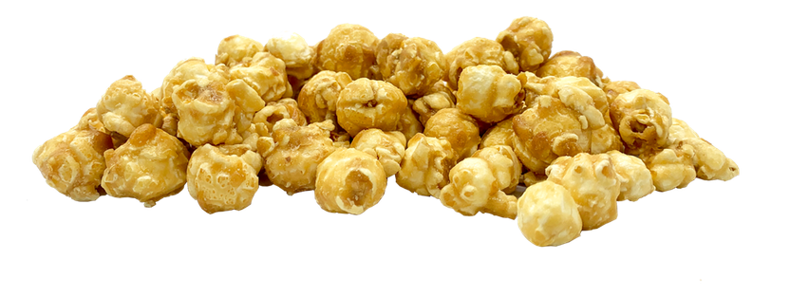
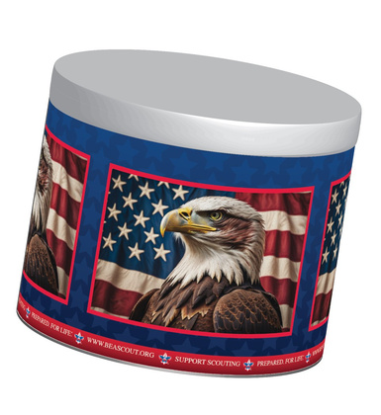
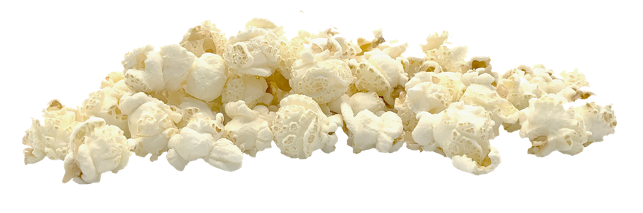

Chicago Style Tin
$50
Chicago Style Mix
Celebrate Scouting with a simply sensational collection of White and Yellow Cheddar Cheese along with Delicious Caramel Corn
(3 BIG Bags!)

Slide 7


Military and Hometown Heroes
$1
$30
$50

Slide 8
Donations
Why Entering Every Dollar Matters
Scouts earn recognition & incentives
Units fund their programs
Councils fund camps & Scouting
If not: Scouts lose credit, Councils lose support, participation declines

Slide 9
2026 Online ordering
2026 Updates
60% RTS (Before BSA fee)
Flat rate Shipping
All Sales goes towards Scout Prizes
Contests enhance participation
Focus on Bundles for more Sales
Keeping product costs down

Slide 10
Prizes & Rewards Plan for 2026
Reward Programs
- High Achievers ($3,000+ sellers get 4% extra commission)
- Reward structure starts at lower levels, increasing participation
- COUNCIL PRIZES

Slide 11
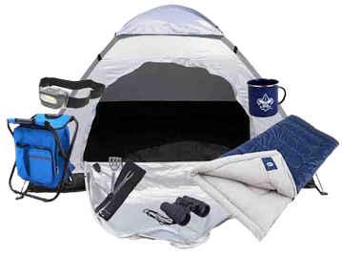
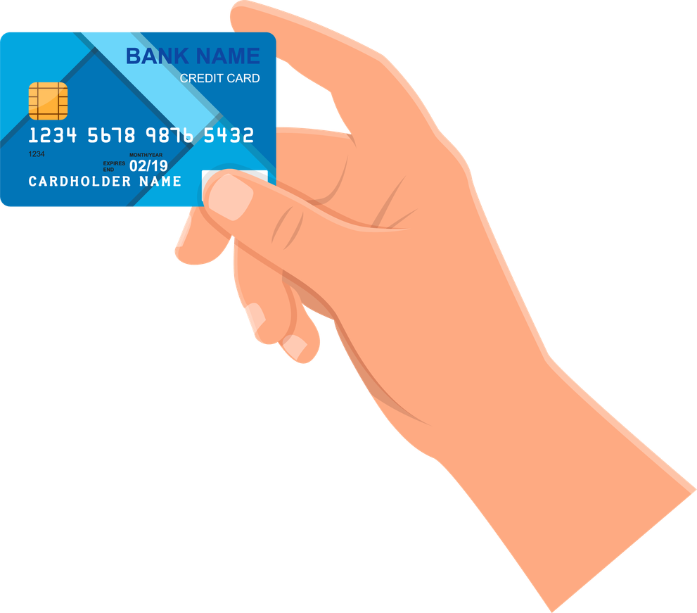
High Achiever Prizes
2026 Exclusive Unit Incentive
High Achiever Prize Program
or
Scouts can earn back 4% of their total sales!
MINIMUM SALES OF $3,000

Slide 12

Camp Master Prize Programs
Fundraising Contests
$400
Sell $400 Online and get a $10 Amazon Gift Card
AUG
Early Bird Fundraising Achiever
SEP
Labor Day Top Sellers Giveaway
SEP
Ultimate Gamers Giveaway
OCT
Sell All 3 Ways Giveaway
OCT
Halloween Top Sellers Giveaway

Slide 13
Selling Tips and Best Practices
Let’s get Ready for Show and Sell!
Tell them who you are – First Name Only!
Tell them where you are from.
Tell them what you are doing.
Tell them what they can do for you.
Close the sale!

Slide 14
To Succeed You Must Remember One Thing!
You Are
NOT
Selling Popcorn!

Slide 15



Slide 16

Allow the boys to do all of the selling.
Use a money pouch that the kids control. Allow them to handle the entire transaction without help unless requested.
Location Supervisor keeps a separate money pouch in car and controls excess cash.
Alert scouts to potential customers.
Talk to customers about the boys community service involvement.

Slide 17

Get The Customers Attention
“Excuusse Me SIR / MA’AM!”
Maintain Eye Contact!!!!
If the customer is not looking at you
or you are not looking at them,
SOMEBODY IS NOT PAYING ATTENTION
Keep The Customer Focused (Bringing ‘em back)
Motion creates Emotion
Energy = ENTHUSIASM
Superlatives are SUPERWORDS
“Deeeelicious”

Slide 18
You are Selling
The Scouting Program!
And isn’t this something you already believe in?

Slide 19



New and Improved Dashboard
Unit and Council Tools
TRAINING VIDEO IMPLEMENTATION
Training videos for each step of our online ordering process are embedded into the ordering system
STOREFRONT SCHEDULING
TAP TO PAY
A new checkout feature that allows consumers to pay on the Camp Masters app via Tap to Pay. This eliminates the need for Square readers.
Inventory Management
GOAL TRACKING
A retired goal tracking feature was brought back by request of our councils and is new and improved.
$1,000,000

Slide 20
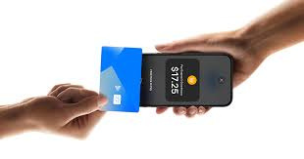


Storefront, Tap-to-Pay, and Inventory Management
- Tap to Pay for Apple & Android (no need for card readers)
- Robust reporting dashboard for tracking sales & inventory
- One-click storefront booking One-click storefront booking & unit flexibility & unit flexibility

Slide 21
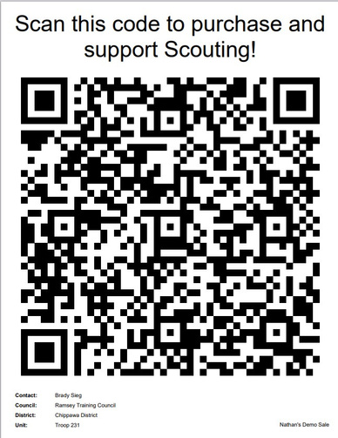
Technology Review – Sales Made Simple
Scannable QR Scannable QR Codes linked Direct to
Store Fronts
or
Scouts
Codes linked Direct to
Store Fronts
or
Scouts

Slide 22
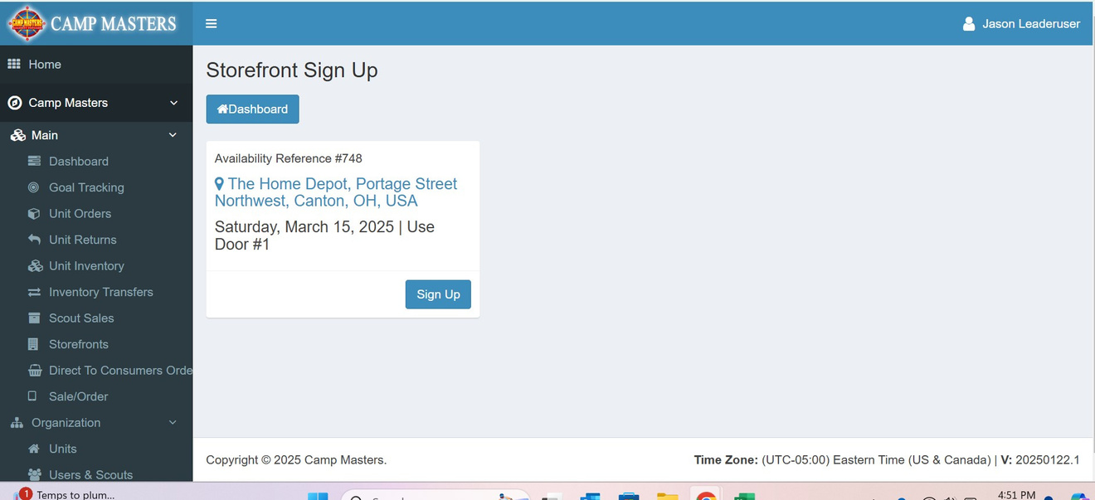
Storefront Scheduling

Slide 23
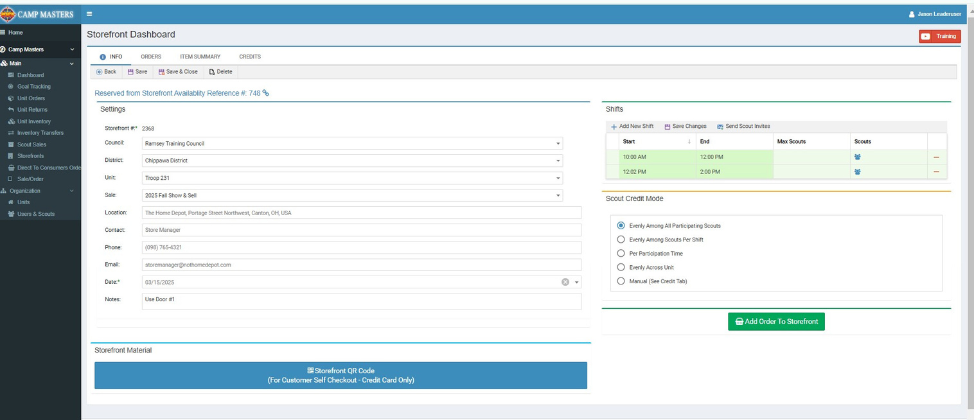
Storefront Scheduling

Slide 24
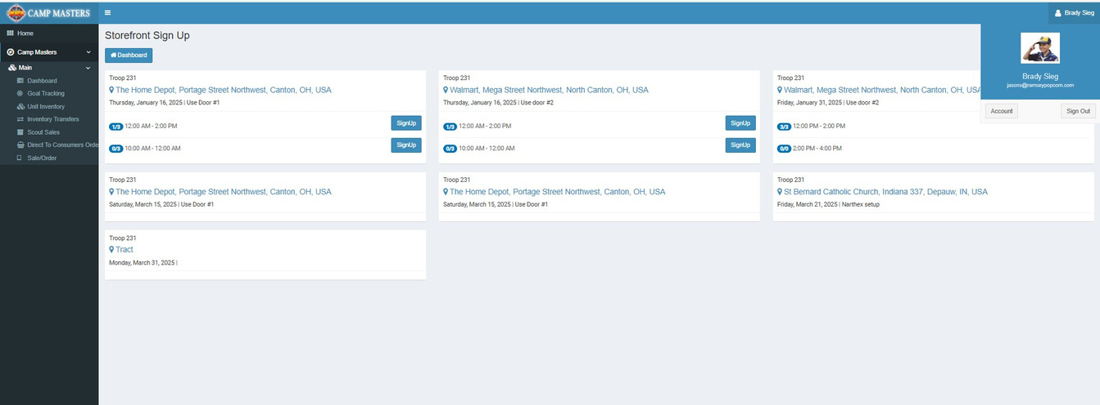
Storefront Scheduling

Slide 25
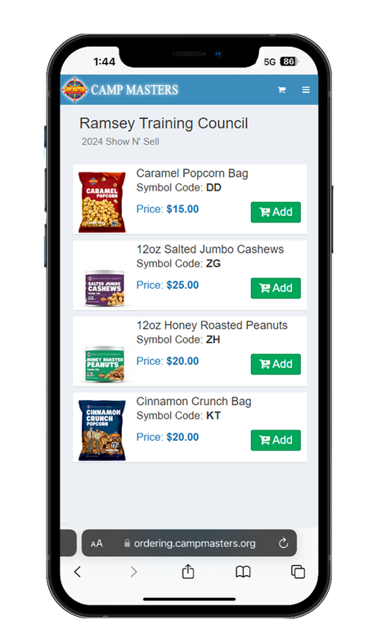
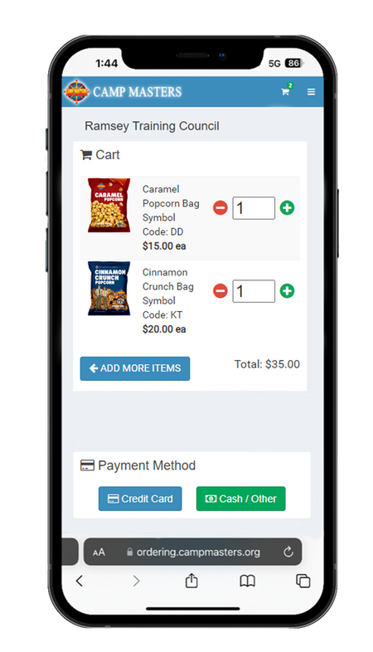
TAP TO PAY
Add Products
Confirm In Cart

Slide 26
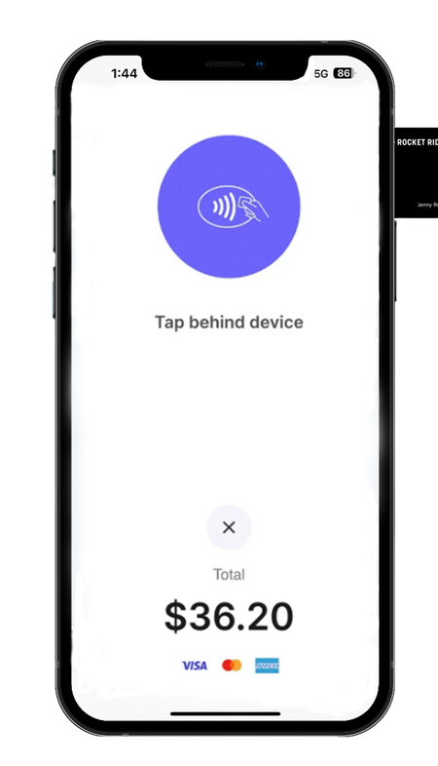
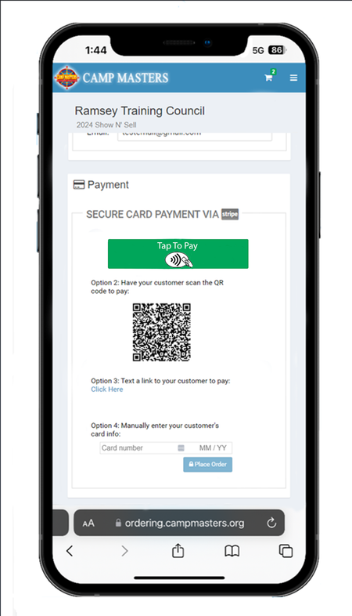
TAP TO PAY
Select Payment
Tap Card

Slide 27
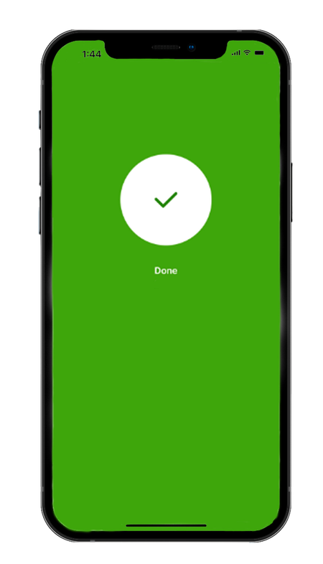
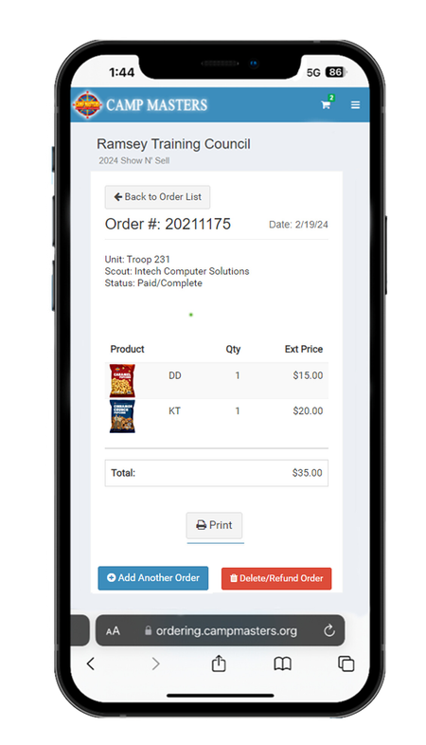
TAP TO PAY
Payment Confirmed
Order Complete

Slide 28

Goal Tracking
Dashboard Goal Tracking
retired goal tracking feature was bro New and Improved Goal tracking feature for councils and scouts to stay on track and have visibility into reaching the set goals.

Slide 29
2026 Knowledge Base
Camp Masters Training
In 2026 Camp Masters is expanding to Knowledge base to provide councils, leaders, and families with instant access to training, videos, FAQ's and support resources-making it easier than ever to tun a successful popcorn sale
Additional training will be provided throughout the popcorn sale, and one-off training can be help on scheduled dates.

Slide 30
Resources
Helpful Links
Zendesk- campmasters.Zendesk.com- use Zendesk email
Customerservice@campmasters.org
Camp Master Facebook Page-
https://www.facebook.com/groups/campmastersunitsparentsandscouts
Lee Anne Franklin- Sales Representative
leeanne.franklin@ramseypopcorn.com (859) 608-4283
Training Video and Implementation- CM You Tube Videos

Slide 31
Thank You!
Helpful Links

